Slide 1
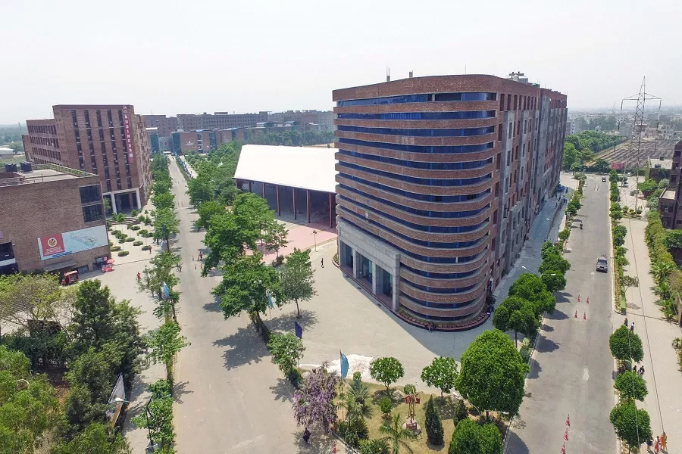
EstimationOf Carbon Dioxide Emission From Cars And Bikes In LPU

Slide 2

THE CARBON
Green carbon
Green carbon is all About Co2 present in our Atmosphere.
The amount of Co2 Without which Our planet is a frozen hunk of rock like Mars.
It is the beating heart of our planet.
It’s the carbon of the living things , carbon of the climate.
Therefore this carbon does not effects the climate to change.

Slide 3
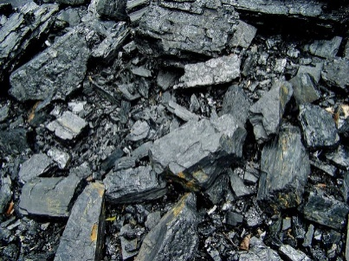
Fossil Carbon -
-> So How They Formed – Due To The Partial Decomposition of the Dead Organism in the prehistoric periods .
-> Fossil Carbon contains lots of carbon and energy in concentrated form and when we burn the fuel for the energy production we releases lots of carbon in the atmosphere that can’t be able to join the carbon cycle.
-> Thus absorbing more amount of heat and energy coming from the sun which is reflected by the earth surface.
-> The Fossil Carbon is the cause of change in climatic conditions , the green carbon not effects the climatic condition.

Slide 4

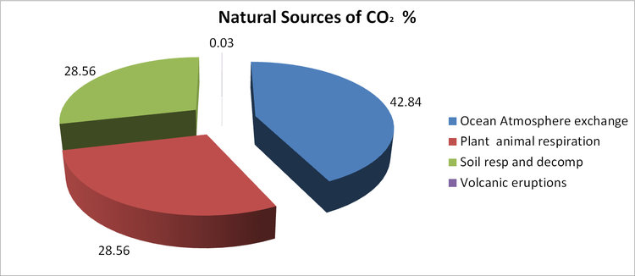
SOURCES OF CO2 EMISSION
Natural sources

Slide 5

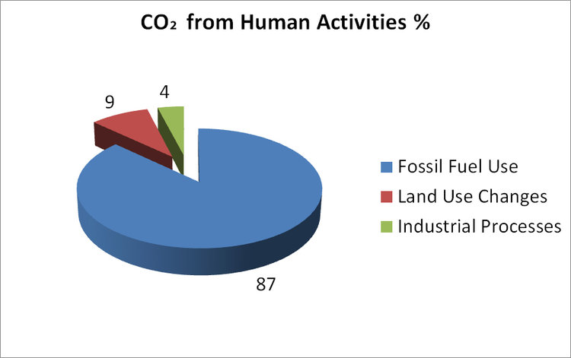
SOURCES FROM HUMAN ACTIVITIES
MORE FACTORS
Land use changes- accounting for 9% of human carbon dioxide emissions and contributed 3.3 billion tones of Carbon dioxide emissions in 2011.
Transportation sector- Transporting goods and people around the world produced 22% of fossil fuel related carbon dioxide emissions in 2010.
Electricity/Heat sector- This sector produced 41% of fossil fuel related carbon dioxide emissions in 2010.

Slide 6

CARBON EMISSION IN INDIA
->Estimated more than 5.7% of Global Co2 emission in
2008 clearly shows the trend of rapid increase.
->Co2 emissions have more than tripled between 1990 and
2010.
->A Large share is from Heat And Electricity Sector .
-> And the stats of 2018 shows emission which accounts to
2.7 billions tons .
->Which is 7% of total global carbon emissions.
->Making our INDIA 4th largest contributor .
-> Carbon emissions from coal constitutes 65% of total .

Slide 7
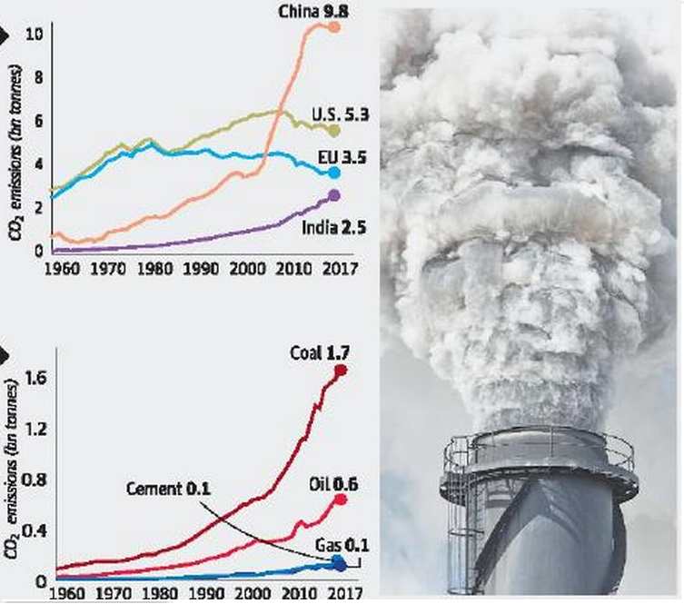

Slide 8
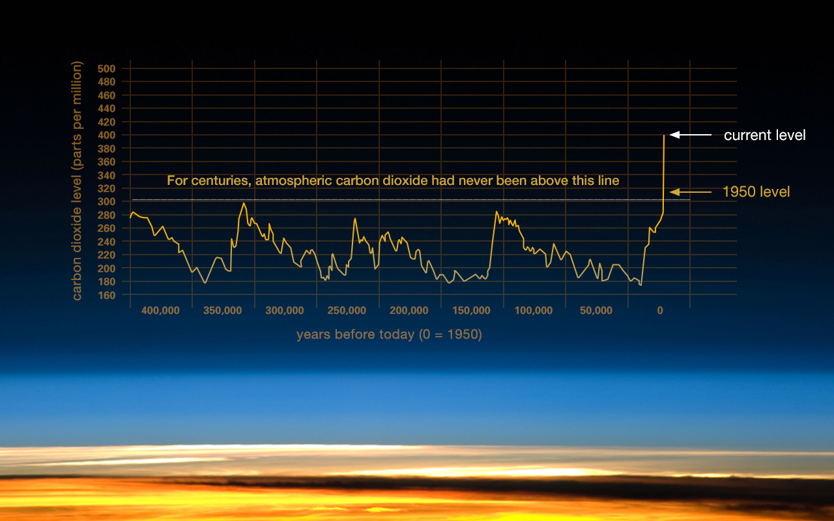

Slide 9


PROCEDURE OF CO2
Engine converts the fuel into the Mechanical Energy to drive the wheels.
This process produces Co2.
FROM
-> One Litre of Diesel weighs 835 grams and consist of 86.2% carbon (about 720 grams of Carbon/litre diesel).
->In Order to Combust this carbon to Co2 , 1920 grams of Oxygen is needed
In Total 2640 grams of Co2/litre will be released.
-> An Average consumption of 5 litres/100km then corresponds to 5 litres*2640/ 100 km = 132 g Co2/km.

Slide 10


FOR
-> One litre of Petrol weights 750 grams .
->Out of which 87 % (652 grams) of carbon is present .
->For the combustion of this carbon to CO2 1740 grams of oxygen is needed .
In total 2392 grams of CO2/litres will be released.
->So an average consumption of 5 litres/100 km then corresponds to 5 litres * 2392 /100 km = 120 g CO2/km

Slide 11
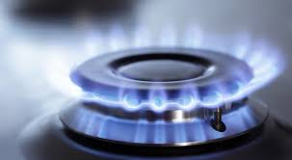
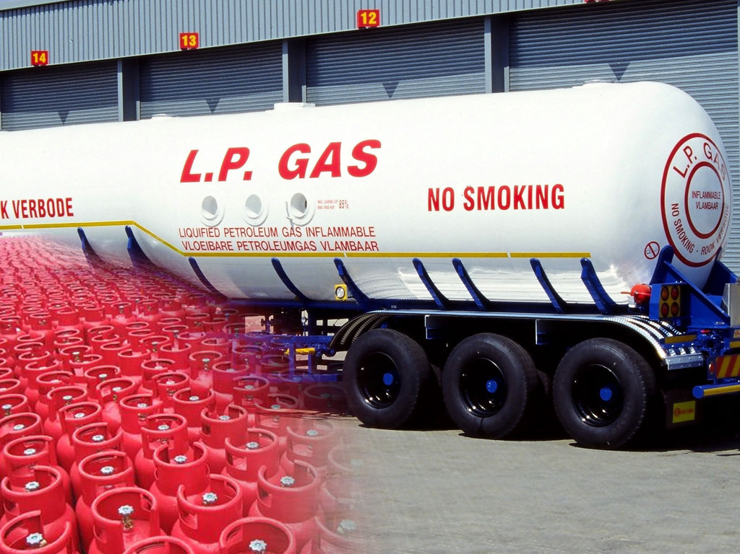
FOR LPG
-> One of the less carbon emitting source of fuel.
->One litre of LPG weights 550 grams .
->Consist of 82.5 % of carbon (454 grams) of
carbon/litre.
->1211 grams of O2 is needed for combustion.
Total of 1665 g/litres will be emitted.
->An average consumption of 5 litre/100 km then corresponds to 5 litres * 1665 / 100 km= 83 g of CO2/km

Slide 12


HOW WE CALCULATED EMISSION OF CO2
-> We have roamed around our Campus and noted some of the models names of cars and bikes .
-> 50 models of cars.
-> 33 models of bikes.
->Next we have calculated the distance of roads laid across the campus.
One round of the whole campus = 5.3 km
->Small parking + big parking lots = 4
->For calculating the emission
Petrol Vehicles Co2 = 2392 / the mileage of vehicle . {Sources = cardekho.com , zigwheels.com}
Diesel Vehicles Co2 = 2640 / the mileage of vehicle .

Slide 13
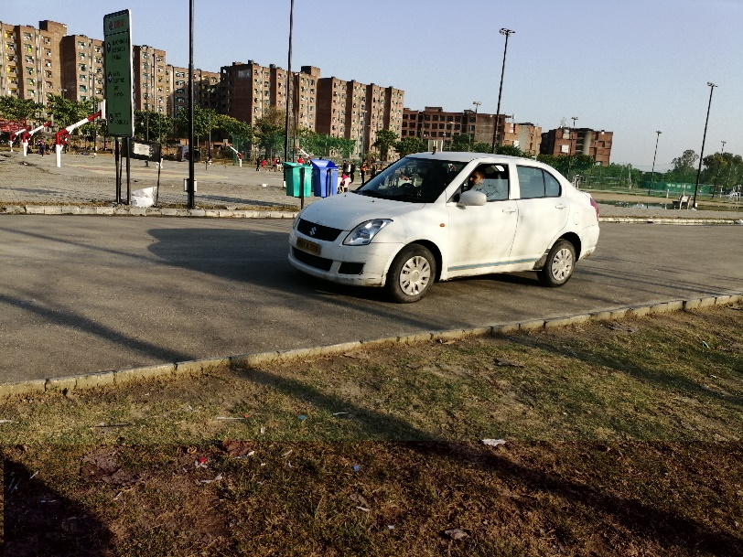
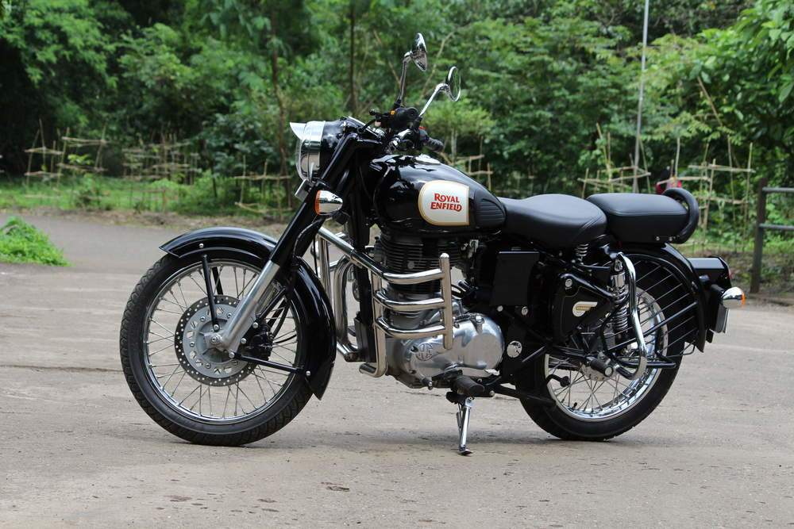
CARS
SOME OF THE MOST REPEATED MODELS OF CARS AND BIKES.
-> ALTO 800 -- 96 g of Co2/km.
-> FORD FIGO -- 117 g of Co2/km. (Petrol)
->MARUTI SUZUKI SWIFT – 122 g of Co2/km. (Petrol)
->HONDA AMAZE – 122 g of Co2/km. (Petrol)
BIKES
-> SPLENDOR PLUS -- 29 g of Co2 /km
-> SUPER SPLENDOR -- 28 g of Co2 /Km
-> PASSION PRO -- 28 g of Co2/km
-> PLUSAR 150 -- 36.8 g of Co2/km
-> ROYAL ENFIELD 350 – 64 g of Co2/km

Slide 14
END RESULTS
-> First we have calculated the average of emission of each bike = sum of Co2 emission of 33 models / 33
which equals = 41 g /km.
-> Similarly for cars we estimated 128 g /km.
-> So estimated number of bikes in parking lots = approx. 600
and 4 bikes / minute enters the LPU’s main gate (11 am to 5pm).
-> Similarly for the number of cars in parking lots = approx. 430
and 2 cars / minute enters the LPU’s main gate (11 am to 5pm).
-> So total bikes(600+1440)= 2040
and cars (430+720)= 1150
-> Now we assumed that half of cars travels 5.3 km and other half 2.6 km .
cars that travel 5.3km= 575 * 128 * 5.3/1000 = 390 kg of C02 in 5.3 km.
cars that travel only 2.6 km= 575 * 128 * 2.6/1000 = 191 kg of Co2 in 2.6 km.
->Similarly for bikes with 5.3 km run = 1020 * 41 * 5.3/1000 = 221 kg of Co2 in 5.3 Km
and for other bikes with 2.6 km run = 1020 * 41 * 2.6/1000 = 108 kg of Co2 in 2.6 km.

Slide 15
BY CARS = 581 KG OF CO2
IN TOTOAL THE CARS AND BIKES EMISSION IN ONE WORKING DAY (MONDAY TO FRIDAY)
BY BIKES = 329 KG OF CO2

Slide 16
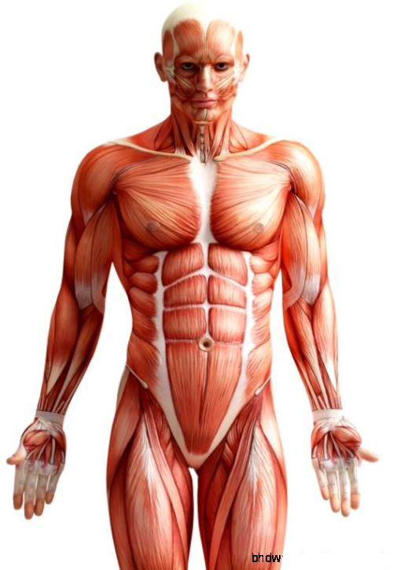
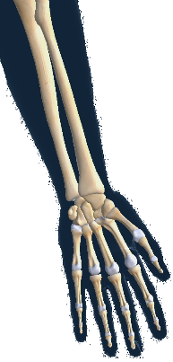
EFFECTS OF
CARBON DIOXIDE
Effects on the human beings
Seizures
Headaches and unconsciousness
Tinnitus
Vertigo and double vision
Suffocation
Changes in Body metabolism.
Decrease in bone calcium
Sources -- https://toxtown.nlm.nih.gov/chemicals-and-contaminants/carbon-dioxide

Slide 17
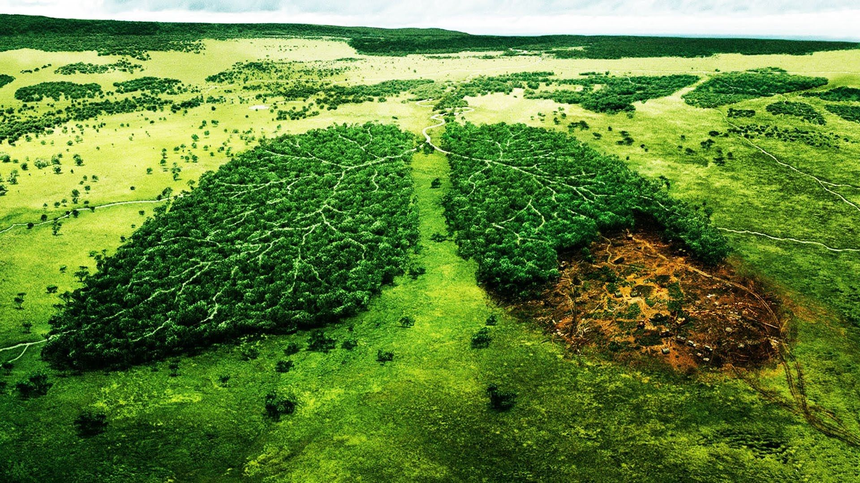
EFFECTS ON THE
ENVIRONMENT
->Carbon dioxide causes about 20 % of Earth’s greenhouse effect.
->Average global temperatures have risen 0.8 degrees Celsius (1.4 degrees Fahrenheit) since 1880.
->About 30 % of the carbon dioxide that people have put into the atmosphere has diffused into the ocean
and creates carbonic acid, which increases the acidity of the water.
limiting the ocean’s ability to take carbon from the atmosphere through the fast carbon cycle
->Since 1750, the pH of the ocean’s surface has dropped by 0.1, a 30 % change in acidity.
->When the soil warms, the organic matter decays and carbon in the form of methane and carbon dioxide seeps into the atmosphere.
->Tropical forests may also be extremely susceptible to drying. With less water, tropical trees slow their growth and take up less carbon, or die.

Slide 18
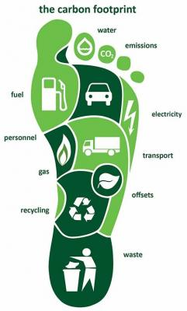
CARBON FOOTPRINT
HOW WE CAN CUT OUR
-> learn the 5 R’s: refuse, reduce, reuse, rot, recycle.
-> Consider installing solar panels on your home.
-> Fly less.
-> WE can reduce CO2 emissions by the vehicles we use:
purchasing the most fuel-efficient vehicle that meets your needs
take Public Transport, Carpool, or Bike.
using fuel-efficient driving techniques

Slide 19
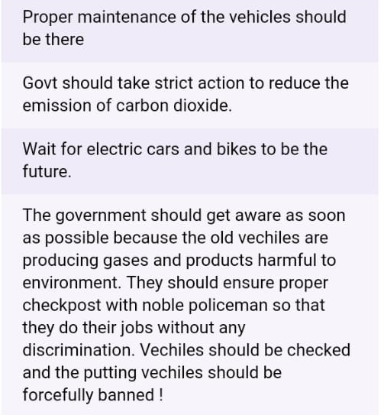
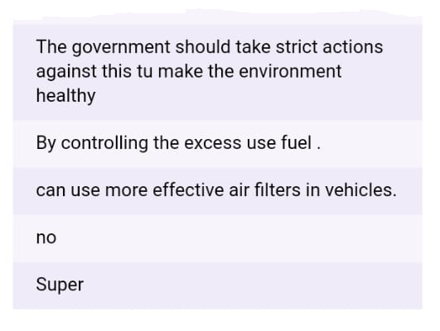
SURVEY DONE BY US
SOME OF THE ANSWERS WE GET THROUGH OUR FORM

Slide 20

SOME OF THE
FUEL EFFICENT
DRIVING TECHNIQUES
-> Drive smoothly – avoid unnecessary acceleration and braking.
-> Drive at an appropriate speed- A steady speed of 50 mph can improve fuel economy by 25 % compared to 70 mph.
-> Less starting and stopping means less CO2 emission.
-> Idling is wasting fuel
Sources -- https://www.nrcan.gc.ca/energy/efficiency/transportation/21038

Slide 21
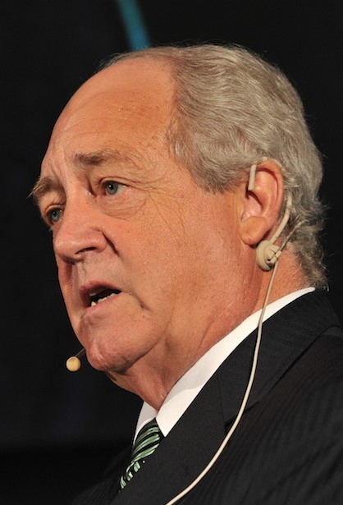
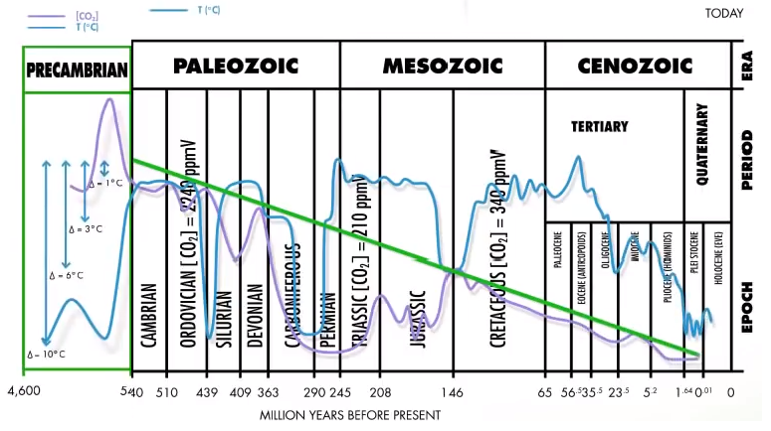
OTHER FACE OF THE COIN
POSITIVE EFFECTS OF EXCESSIVE CO2 EMISSION
-> He said that no there is no scientific proof that increase in temperature is caused by CO2.
->In this graph it can be seen that in the EOCENE period justifies his words the blue line is of temp
and purple is of CO2.
Patrick Albert Moore
Sources – Youtube (https://www.youtube.com/watch?v=2kIcFIofUHk)

Slide 22

WHAT NASA DOCUMENATION SAYS
-> With more atmospheric carbon dioxide available to convert to plant matter in photosynthesis, plants were able to grow more. This increased growth is referred to as carbon fertilization. Models predict that plants might grow anywhere from 12 to 76 percent more if atmospheric carbon dioxide is doubled, as long as nothing else, like water shortages, limits their growth.
-> In high and mid-latitudes, abandoned farmland is reverting to forest, and these
forests store much more carbon, both in wood and soil.
Sources -- https://earthobservatory.nasa.gov/features/CarbonCycle/page5.php

Slide 23

THANK YOU !

